Slide 1
@Retention Annotation
@Retention annotation is used to specify to what level annotation will be available.
RetentionPolicy | Availability
RetentionPolicy.SOURCE | Refers to the source code, discarded during compilation. It will not be available in the compiled class.
RetentionPolicy.CLASS | Refers to the .class file, available to java compiler but not to JVM.It is included in the class file.
RetentionPolicy.RUNTIME | Refers to the runtime, available to java compiler and JVM.

Slide 2
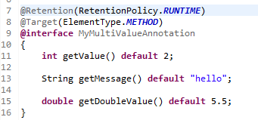
@Retention Annotation
This is how we can specify RetentionPolicy.

